Slide 1
Decomposition & Fungi
What happens to things when they die?

Slide 2
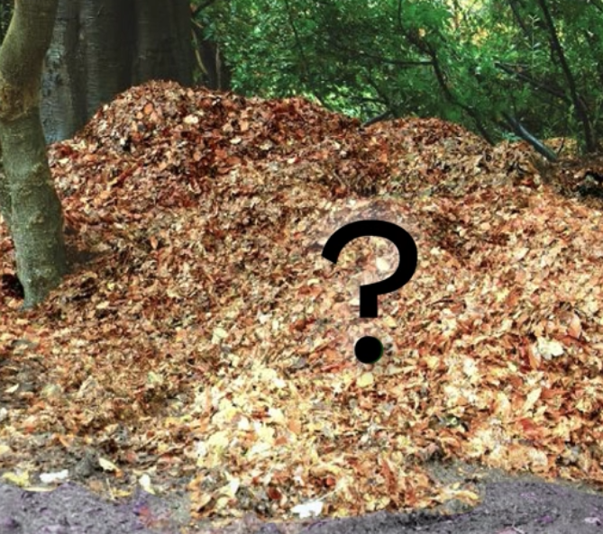
Where do fallen leaves go?
Adapted from Mystery Science lesson
https://mysteryscience.com/ecosystems/mystery-3/decomposers-matter-cycle/95

Slide 3
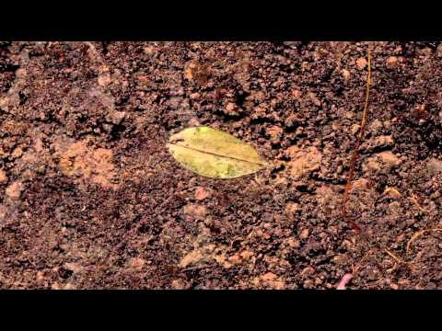
https://www.youtube.com/watch?v=cPhfP8Yu7Zs

Slide 4
What is Decomposition?
Decomposition is the process where dead things are broken down into smaller, less complex parts.
Examples?

Slide 5
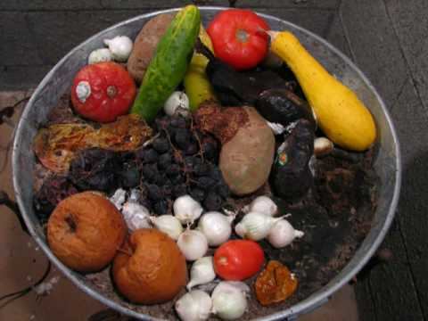
https://www.youtube.com/watch?v=c0En-_BVbGc

Slide 6
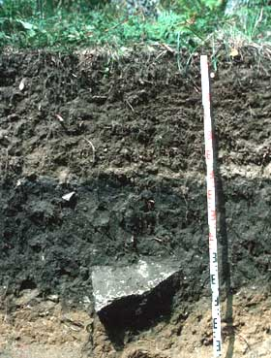

Slide 7
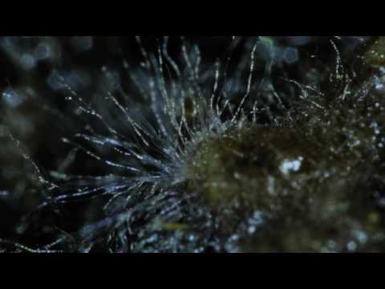
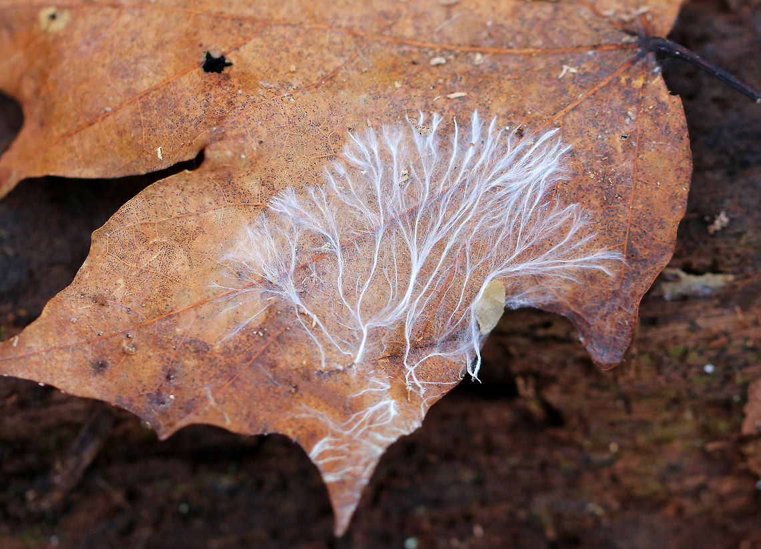
Leaves don't rot on their own!
https://www.youtube.com/watch?v=CVf3R889odU​

Slide 8
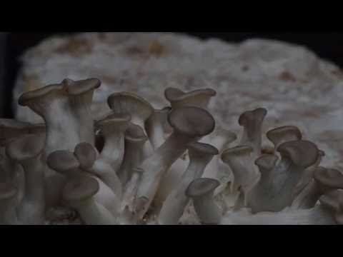
https://www.youtube.com/watch?v=-DSTehPQpek

Slide 9
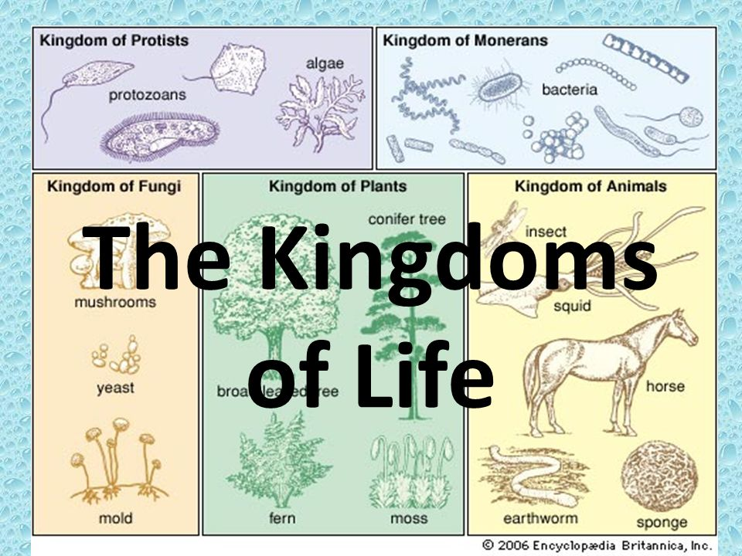
The Decomposers: Fungi
Fungus (plural fungi)- fungi live in soil, water, the air, and even in our bodies. Often microscopic.
Estimated to be over 5 million species of fungi worldwide!
  ~400,000 species of plants
  ~5,000 species of mammals

Slide 10
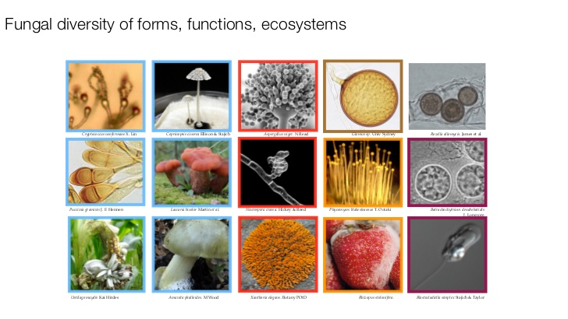
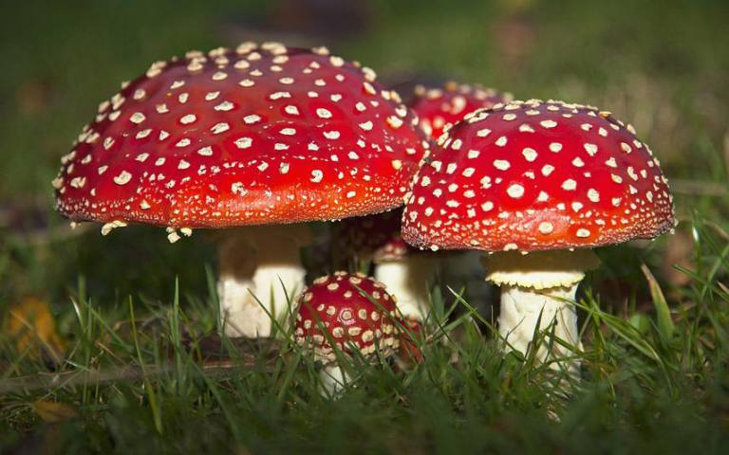

Slide 11
How do fungi eat?
Some fungi have root-like structures (hyphae) that secrete digestive liquids to break down dead material into smaller parts, which they absorb for nutrition.

Slide 12
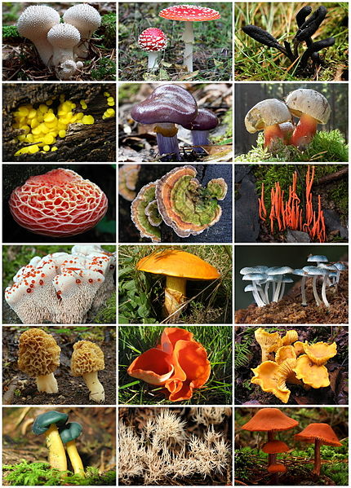
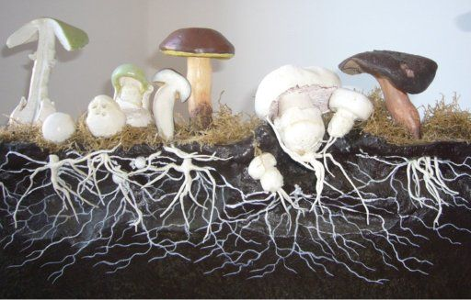
Fungal friends: Mushrooms
Some fungi form reproductive structures called mushrooms that come in a variety of sizes, shapes, colors, and deliciousness.

Slide 13
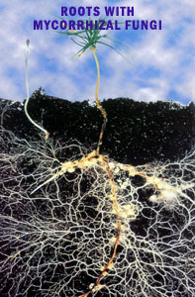
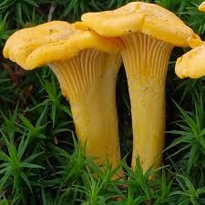
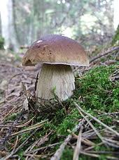
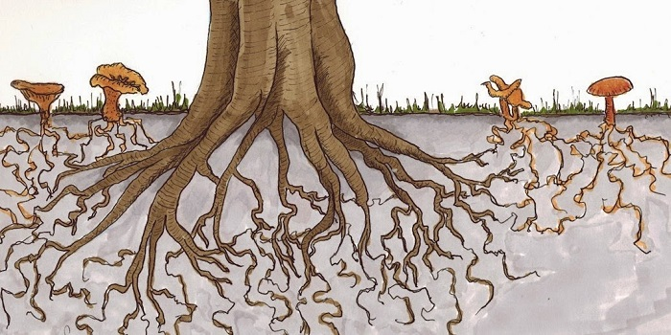
Fungal Friends: mycorrhizal fungi
Some of these root-like structures (hyphae) form symbiotic relationships with plants
Mycorrihza (myco = fungus, rhiza = root)

Slide 14
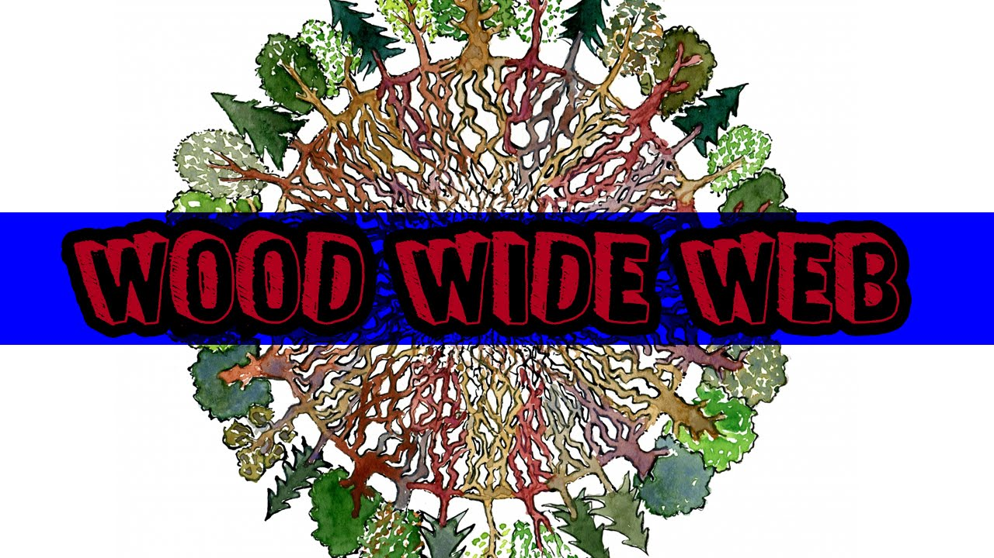
Mycorrhizal networks can form a "wood wide web"

Slide 15
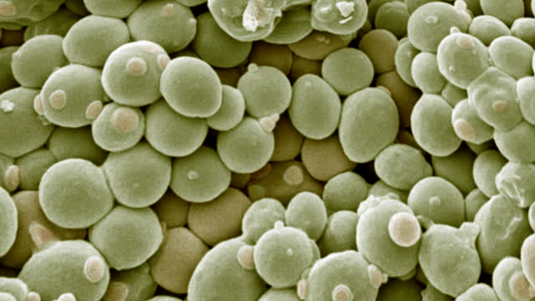

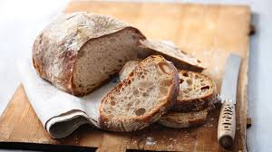
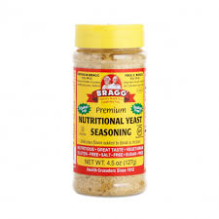
Fungal friends: yeast

Slide 16
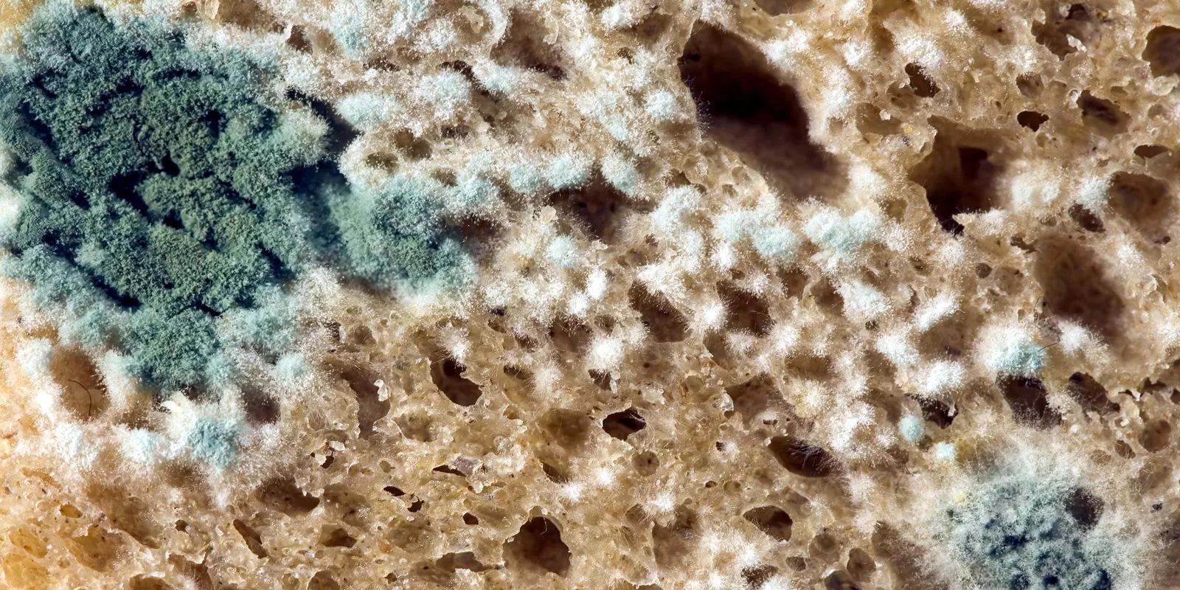
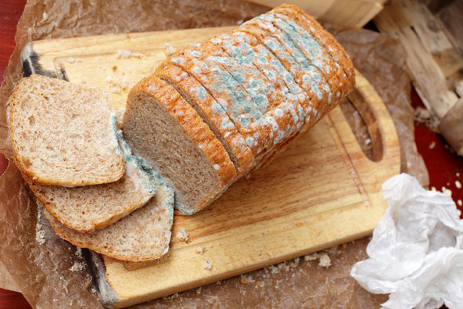
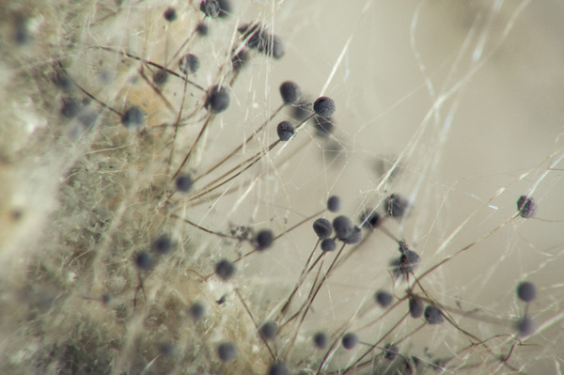
Fungal friends: Mold

Slide 17
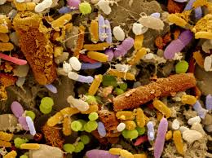
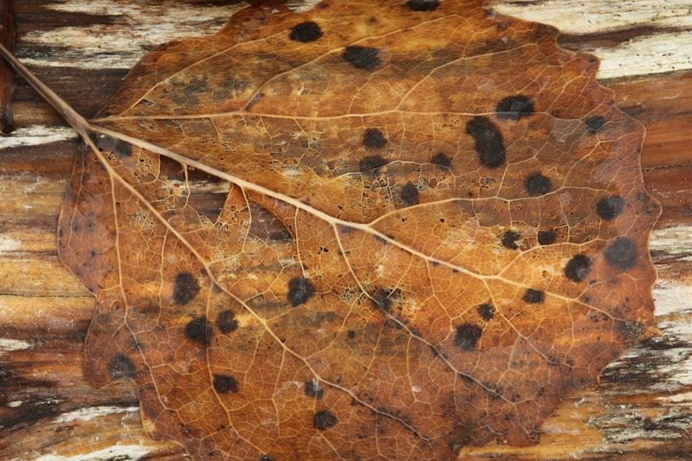
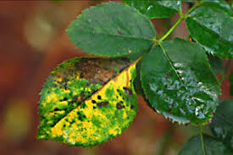
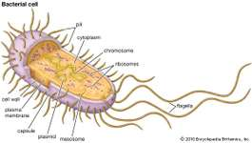
The Decomposers: Bacteria
Bacteria are the most diverse and abundant organisms on the planet! Scientists have found bacteria in every habitat on earth, from the deep ocean to arctic glaciers.
Bacteria are microscopic, but evidence of their activity can sometimes be seen with the naked eye

Slide 18
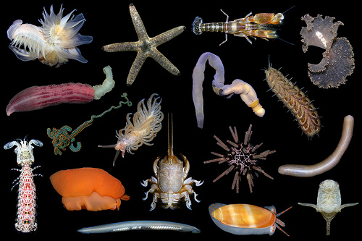
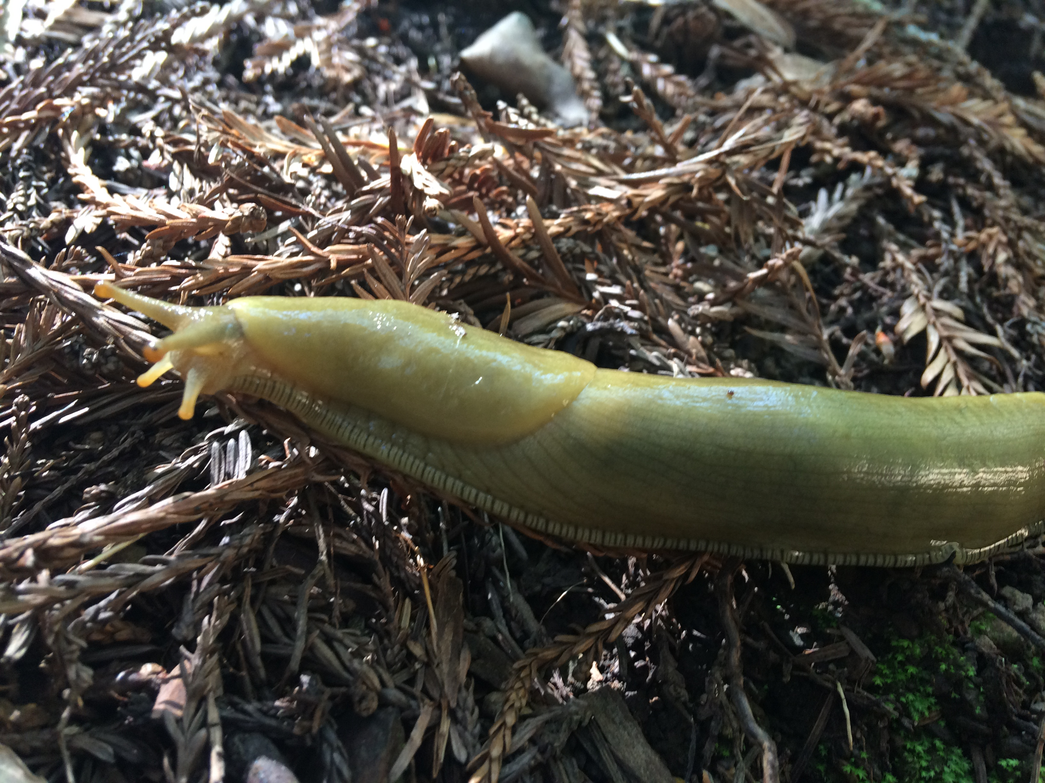
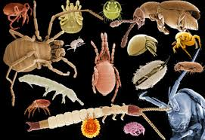
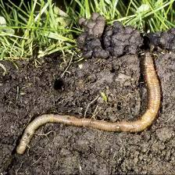
The Decomposers: Invertebrates
Invertebrates are animals without backbones
They chew up dead organic material into smaller pieces for fungi and bacteria to decompose
97% of animals don't have backbones!

Slide 19
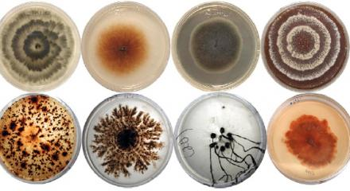
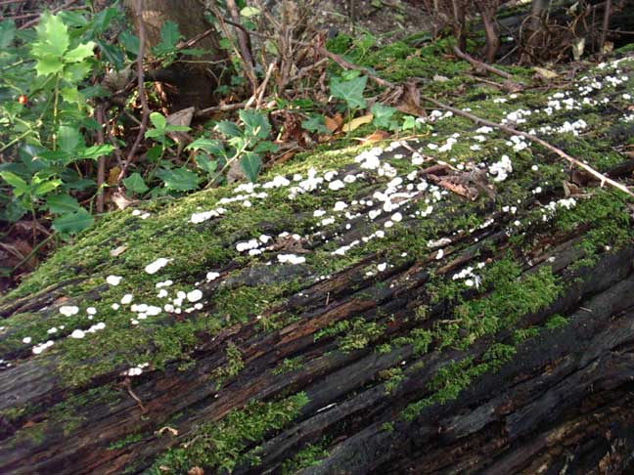
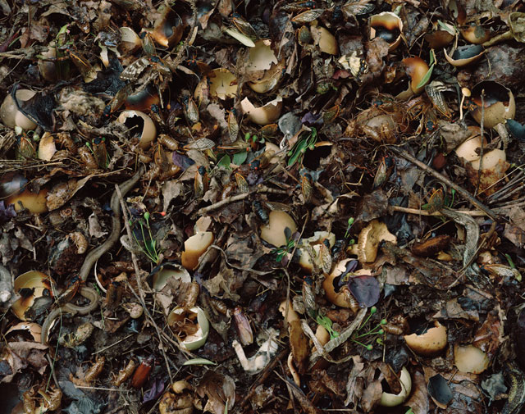
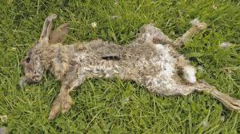
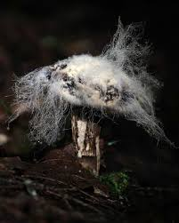
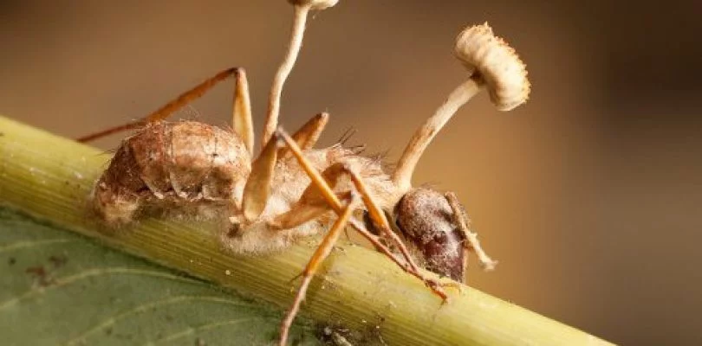
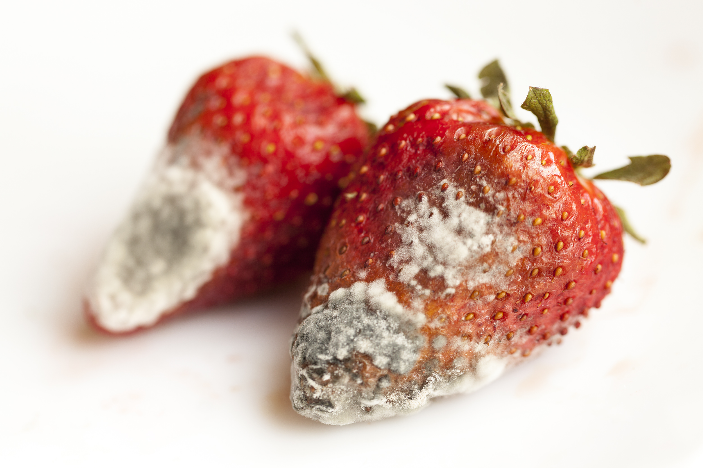
What do decomposers eat?

Slide 20
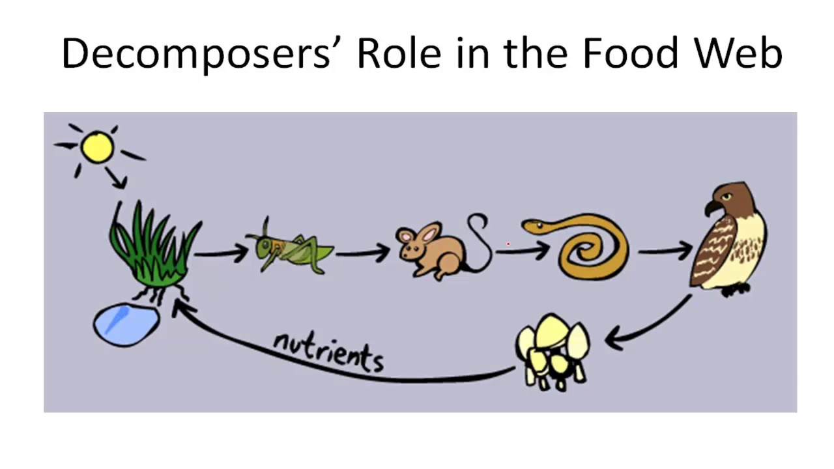

Slide 21
Where do decomposers live?
Everywhere!

Slide 22
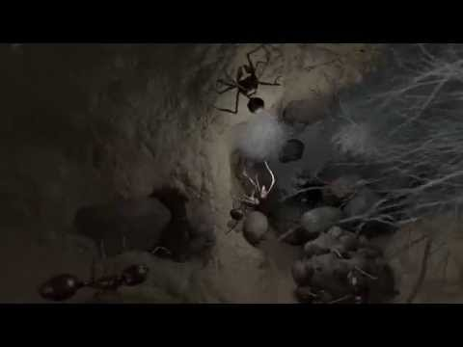
The Living Soil Beneath Our Feet
https://www.youtube.com/watch?v=MlREaT9hFCw

Slide 23
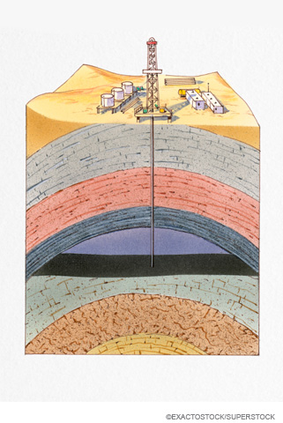
What would a world without decomposers look like?

Slide 24
Bringing it all together
California Academy videos for the classroom
https://www.calacademy.org/educators/science-films-for-the-classroom
See Habitat earth video
https://www.calacademy.org/educators/habitat-earth-in-the-classroom
Start at 5 min 55 sec to 13 min 15 sec
Story of water and nutrient movement from the soil through the trees into the atmosphere and up and down rivers

