Slide 1
Insects in My School Yard!
Introduction to the Bug Hunt (K-6)
Day 2 Tuesday
10 minute Introduction

Slide 2
Intro
If you’ve ever seen an insect raise your hand!
Awesome, today we will be talking all about insects!

Slide 3
Insect Introduction
Show picture
Can anyone name some insects?
So we see them and we know what they are, but..
What makes an insect an insect?
Write Insect on board, review characteristics
Insect – An arthropod with 3 body parts and six legs.
Notes:
6 legs and 3 body parts are key features distinguishing insects from other arthropods.
Insects also have 2 pairs of wings (usually), 2 antennae, an exoskeleton, and jointed appendages

Slide 4
Quiz Time – Are these insects?
On the count of three say “Insect” or
“Not-Insect”!

Slide 8
Insects – Where do they live?
Now that we all know what insects are, let’s think about where they live!
Make groups of two
With your partner, discuss where you think insects live for 1 minute.
Insect – An arthropod with six legs.
Notes:
Guiding question – “Where do insects live in our schoolyard?” Or “Where do most insects live in our schoolyard?”

Slide 9
Habitat
Recall from yesterday, what do we call these environments that these insects live in?
  Define Habitat
Insect – An arthropod with six legs.
Habitat – A place or environment where organisms live.

Slide 10
Habitat
Show map of the school
Let’s get more specific and think about the bugs around us!
Where do you think insects are living around the schoolyard?
Let’s write them down together!
  Show map of the schoolyard.
  Write down answers
Insect – An arthropod with six legs.

Slide 11
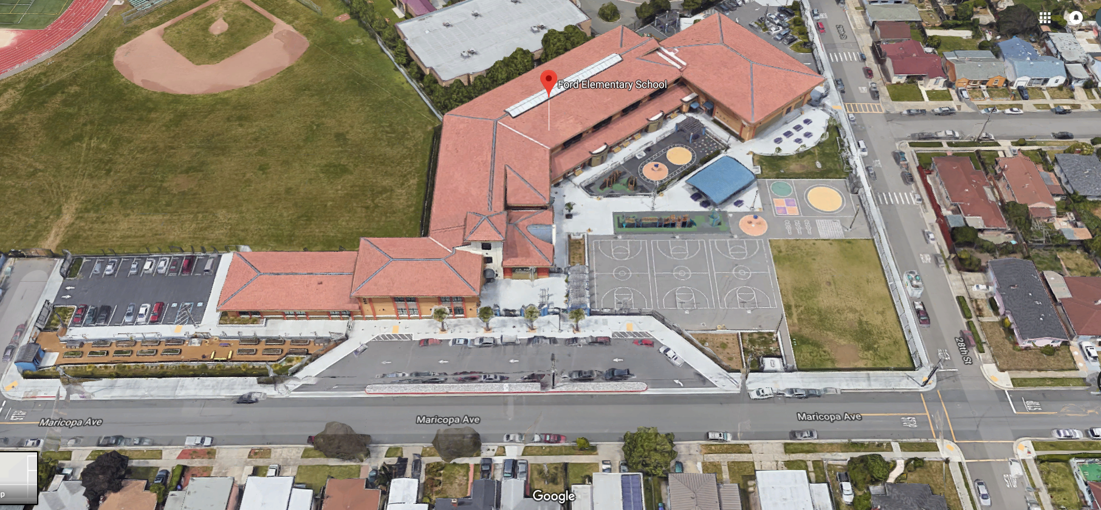

Slide 12
Habitat Predictions
From the habitats listed, where do you think we will find insect?
Green circle around habitats they will find them in.
Black circle around habitats they will not find them in.

Slide 13
Make Field Teams
Form groups of 4.
Pick one green habitat and one black habitat to compare from the list on the board.
In our notebook write down:
  the guiding question (Where do we find insects in the schoolyard?)
  your two habitats
As a group, decide together which habitat will have more insects.
Write down your prediction in your notebook.
  “I predict I will find more insects in _____ than in the _____, because _________________.”

Slide 14
Equipment Instructions
Each group will be given:
  Plastic snap-cap vials
  Aerial nets
  Beat Sheets
  Tubs with labels for each habitat.
  Hand out equipment.
Notes:
Keep track of where you find the insects you collect

Slide 15
Equipment Demo
Aerial net tutorial
  How to swing the net
  How to fold over the top to catch insects
  How to put bugs in the vial.
Beat sheet tutorial*
  Hold the sheet (or tub if you have no beat sheet) underneath a plant or branch.
  Tap the plant --- no need to be rough, just need to dislodge insects.*
  Collect bugs that drop onto the sheet into the plastic vials.
  *You can only use the beat sheet on plants
  **Do not hit plants hard – just tap gently
Notes:
You can use a beat sheet or if you don’t have one you can just use a tub like a dish tub or a foil tray or even a shoe box
You can also catch by hand or right into the vials

Slide 16
Field Instructions
When outside, record notes/observations about the habitat for each of your sites (what kind of vegetation, moisture, weather, sun/shade, etc.)
Collect!
After 20 minutes, come back to the classroom with your vials and equipment.
Be sure to keep track of where you found each specimen you collect.

Slide 17
Go Out and Collect Bugs!

